Slide 1
54MW SOLAR POWER STATION
CONSTRUCTION PROJECT IN YAGOTYN DISTRICT, KIEV REGION
"NVK "COGENERATION" LLC

Slide 2
PROJECT SUMMARY
The main idea is the construction of a 54 MW solar power station, based near the Yagotyn city, Kyiv region.
The installation of solar panels from TIER1 manufacturers list and recommended inverter equipment, polycrystalline solar panels are considered. The best offer will be chosen at the time of the project start with the delivery of equipment to the power plant.

Slide 3
Importance of the location
Power supply
Region base
Yagotyn district of the Kyiv region is in the zone of high solar activity and average temperatures, as well as in the territorial zone, where there are no dust storms and dirty rains. These factors contribute to the maximum efficient generation of electrical energy by panels (1250 kWh per 1 kW of power on average) and contribute to reliable and long-term operation of the entire equipment complex.
The territory of potential Yagotyn SPS is 94 hectares and is conveniently located: the distance the nearest 110 kV substation is less than 1 km.
Highway
The territory of potential Yagotyn SPS is located within the boundaries of the Yagotyn city. This makes it possible to ensure prompt observation of SPS equipment and a high-quality protection. Good roads allow you to quickly deliver workers and the necessary auxiliary equipment and to reduce the cost of SPS maintenance.

Slide 4
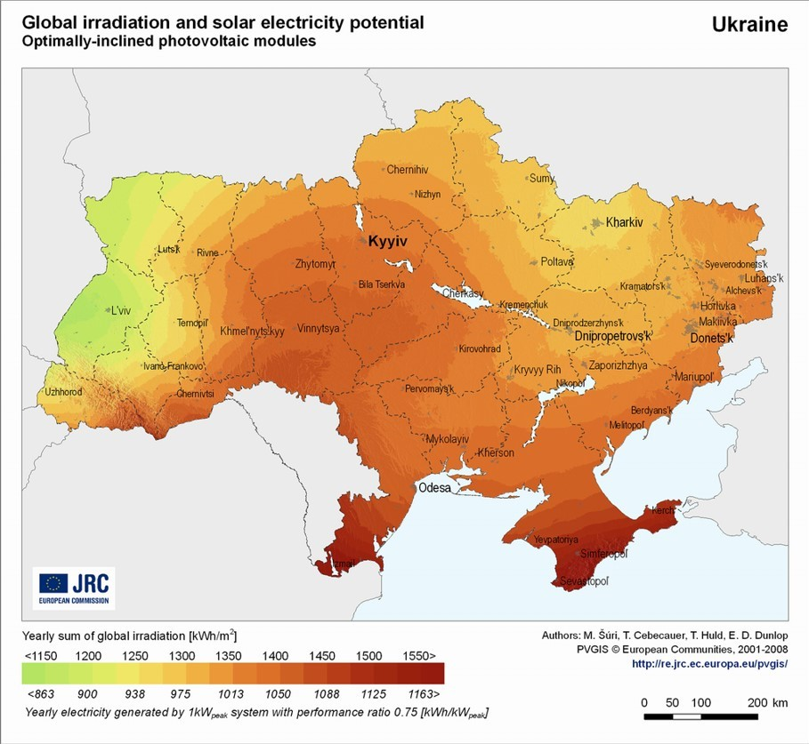

Slide 5
Benefits and prospects
DEVELOPMENT
SECTOR
PROSPECTS
THE COST OF ENTRY
“THE GREEN TARIFF”
PUBLIC SPHERE
The experience of building similar stations indicates the cost of 1kW of installed capacity - $ 1100.
State supports the sector due to “The Green Tariff” and tax benefits. The minimum "Green Tariff" is fixed to 2030 and is 15 euro cents / kWh.
According to the Decision of the Energy Community Ministerial Council, Ukraine has taken an obligation to reach 11% of energy production from renewable sources by 2020 (6% as for today).
There is a high solar activity and moderate climate in Ukraine, which contributes to the high efficiency of solar panels in the summer.
4
5
The Green Tariff for all types of power plants that produce electricity from alternative sources will decrease when compared to the level of 2016
Imported equipment is free of customs duty and is exempted from VAT, if the relevant equipment is not being produced in Ukraine
1
6
Preferential tariff by the year of 2030
The rental rate for the land that is used for renewable energy facilities is reduced to 3% of the land value, compared to the standard 12 % rate
2
Linked tariff to the EUR
3
Monthly regulation of “The Green Tariff" by NKREKP

Slide 6
The key project parameters
The main equipment of the solar power plant are polycrystalline solar panels and DC inverters. This equipment is standard and is selected from the TIER1 companies list at the time of the project start on the principle of maximum economic feasibility.
Overall TTP data
Capacity | MW | 54
Construction period | months | 6
Staff | person | 12
“The Green Tariff” | EUR/kWh | 0,15
Investments | USD | 48 600 000
The technological cycle of the station is working every day during daylight hours.
The estimated cost of similar projects based on new equipment is about 1000-1300 USD per kW, the cost of our project is 900 USD per kW.

Slide 7
The results of the 54 MW Yagotyn SPS construction project
Name of indicator | Period
 | 2018 | 2019 | 2020 | 2021
Profit (excluding VAT) | 0 | 12 150 000,00 | 12 150 000,00 | 12 150 000,00
EBITDA | 0 | 12 000 000,00 | 12 000 000,00 | 12 000 000,00
Amortization | 0 | 195 000,00 | 195 000,00 | 195 000,00
Income tax | 0 | 2 124 000,00 | 2 124 000,00 | 2 124 000,00
Net Profit |  | 9 676 000,00 | 9 676 000,00 | 9 676 000,00
R, % |  | 19,91 | 19,91 | 19,91

